Slide 1
S J C INSTITUTE OF TECHNOLOGY
DEPARTMENT OF COMPUTER SCIENCE AND ENGINEERING
Mini- Project work
On
“Blogging Website”
PRESENTED BY
Vidyashree T S 1SJ21CS179
Shaik Al Kashifah 1SJ21CS188
Vinutha T N 1SJ21CS190
Keerthana R 1SJ22CS402
UNDER THE GUIDANCE OF
Prof. Swetha T Prof. Divakar K M Dr. Manjunatha Kumar B H
Assistant Professor Assistant professor Professor & HoD
Dept. Of CSE,SJCIT Dept. Of CSE,SJCIT Dept. Of CSE,SJCIT

Slide 2
CONTENTS
I. ABSTRACT
II. INTRODUCTION
III. LITERATURE SURVEY
IV. PROBLEM IDENTIFICATION & DEFINITION
V. SIGNIFICANCE
VI. OBJECTIVES
VII. METHODOLOGY
VIII. PLAN OF EXECUTION
IX.SYSTEM REQUIREMENTS AND SPECIFICATIONS
X.ANALYSIS OF THE DESIGN AND IMPLEMENTATION
XI. RESULTS AND DISCUSION
XII. CONCLUSION AND FUTURE ENHANCEMENTS
Bibliography

Slide 3
ABSTRACT
In the digital age, blogging has emerged as a powerful medium for individuals to express ideas, share information, and engage with a wide audience. This mini-project aims to develop a fully functional blogging website using HTML, CSS, and JavaScript, focusing on simplicity, responsiveness, and user-friendliness.
HTML will structure the content, CSS will ensure a visually appealing and responsive design, and JavaScript will handle dynamic interactions and functionalities. The Mini project will also incorporate basic security measures to protect user data and provide a smooth and engaging user experience.

Slide 4
INTRODUCTION
This mini project aims to develop a responsive and user-friendly blogging website using HTML, CSS, and JavaScript. Users must log in to access the home page, featuring three categories: Food, Lifestyle, and Technology. They can create blog posts within these categories, and the data is stored in the database. Key features of our mini project include secure user authentication, responsive design, dynamic interactions. The goal is to provide a versatile platform for bloggers, ensuring security and scalability.

Slide 5
LITERATURE SURVEY
Title | Bridging the Gap: A Genre Analysis of Weblogs | Blogging as Social Activity | Effectiveness of Blogging | Blogging to Enhance Language Skills
Authors | Herring, S. C., Scheidt, L. A., Bonus, S., Wright, E. | Nardi, B., Schiano, D., Gumbrecht, M. | Sahil Hans, Shaik Maqsad, Aditya Narayan Swami. | Begona Montero-Fletaa, Carmen Pérez-Sabaterb.
Key points | Analyzes different types of weblogs. Explores how blogs blend personal and professional content. | Investigates blogging as a social activity. Discusses the large audience reach and personal expression. | Highlights blogging's impact on sharing, marketing, education, and data analysis. | Studies blogging in the classroom to improve writing and motivation.
Source | IEEE Computer Society Press. | Proceedings of CSCW2004. | Research paper. | Universidad Politecnica de Valencia.

Slide 6
PROBLEM IDENTIFICATION & DEFINITION
Complexity of Existing Platforms: Many blogging platforms are too complex for beginners or lack advanced features for experienced users.
User Experience Issues: Non-responsive designs and poor interfaces reduce user engagement.
Content Management Problems: Challenges in organizing and managing blog content effectively.
Security Concerns: Inadequate user authentication and data protection.
Definition: Our blogging website mini project addresses these issues by creating a user-friendly, responsive blogging website with efficient content management, robust security, and enhanced community interaction.

Slide 7
SIGNIFICANCE
Enhanced User Accessibility
Improved User Engagement
Efficient Content Management
Strengthened Security

Slide 8
OBJECTIVES
  Implement a secure user login and logout system.
  Develop a user-friendly interface for creating blog posts.
  Enable users to write new blogs in respective categories.
  Ensure the website is responsive and accessible on various devices.

Slide 9
METHODOLOGY
1.Planning and Requirements Gathering
  Define mini project objectives: User authentication, blog creation, and user interaction.
  Specify key features: User registration, login, blog post creation, and responsive design and publish.
  Choose tools: HTML5, CSS, JavaScript.
  2. Setting Up Development Environment
  Install required software: Visual Studio Code, Xampp.
  Organize project structure: Folders for HTML, CSS, JavaScript, and assets.

Slide 10
METHODOLOGY
3. Designing User Interface
  Create wireframes and mockups: Visualize website layout.
  Develop with HTML: Use semantic elements for structure.
  Style with CSS3: Implement responsive design using Flexbox.
4. Implementing Functionality
  User authentication: Build secure login forms.
  Blog post management: Develop a rich text editor for content creation.
5. Deployment and Maintenance
  Ensure compatibility and responsiveness.

Slide 11
PLAN OF EXECUTION
Project Setup and Planning
  Define project objectives and finalize feature specifications.
  Select and set up development tools: Visual Studio Code and Xampp server.
User Interface Design
  Develop the basic HTML structure using semantic elements.
  Begin CSS styling for responsive design.
  Create database for storing the data of blogs.
User Authentication and Database Setup
  Implement user registration and login forms with HTML and JavaScript.
  Initialize database schema (if applicable) and connect with backend services.

Slide 12
PLAN OF EXECUTION
4. Content Creation and Management
  Develop a blog post editor with HTML forms and JavaScript for content handling.
5. User Interaction Features
  Enhance user experience with responsive design adjustments and interactive elements.
6. Testing and Debugging
  Conduct cross-browser testing on Chrome, Firefox, Safari, and Edge.
  Perform responsive testing on various devices (desktop, tablet, smartphone).

Slide 13
SYSTEM REQUIREMENTS AND SPECIFICATIONS
Software Requirements:
Frontend: HTML,CSS,JS
Tools: Visual Studio Code and Xampp server for database
Operating System: Windows 7(64 Bit), Windows 8 (64 Bit), Windows 10 (64 Bit)
Hardware Requirements:
Processor: Intel core i3 or equivalent (minimum)
RAM: 4GB(minimum), 8GB or more (recommended)
Harddisk:10GB of free space

Slide 14
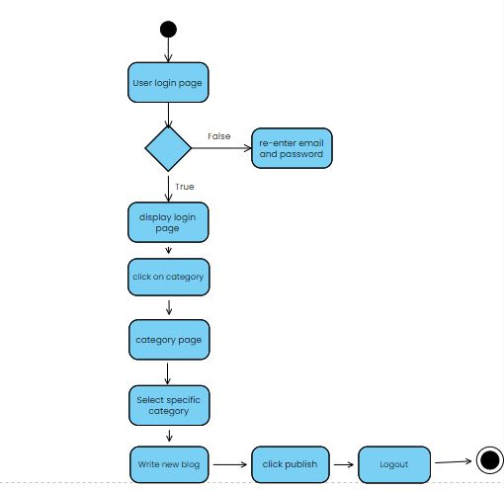
ANALYSIS OF THE DESIGN AND IMPLEMENTATION

Slide 15
ANALYSIS OF THE DESIGN AND IMPLEMENTATION
Design Strategy:
Objective: Simple, responsive, and user-friendly blogging website using HTML, CSS, and JavaScript.
User Interface: Intuitive navigation ensuring ease of use across devices.
2. Implementation Process:
HTML: Structured content with semantic elements.
CSS: Applied styles and media queries for responsiveness.
JavaScript: Enabled dynamic features like form validation and interactivity.

Slide 16
ANALYSIS OF THE DESIGN AND IMPLEMENTATION
3. Challenges and Solutions:
Responsive Design: Used flexible grids and media queries.
Security: Implemented input validation and secure storage.
Performance: Optimized loading times and resources.
4. Outcomes:
Engagement: Increased user interaction.
Scalability: Foundation for future enhancements.
Learning: Practical experience with web development and security practices

Slide 17
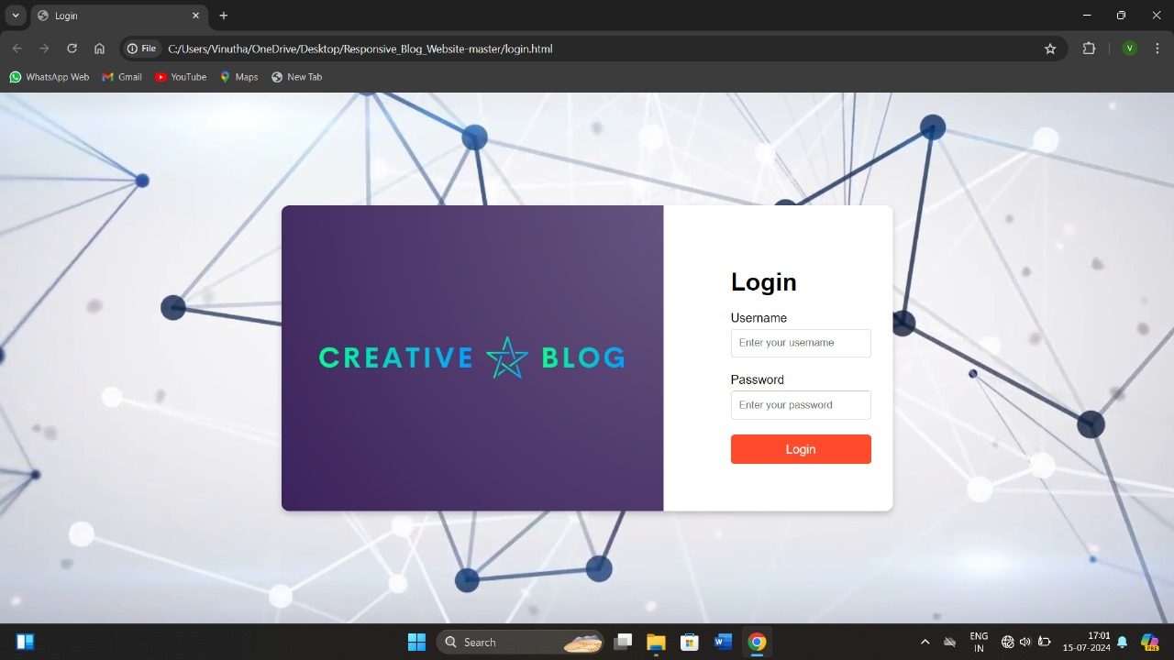
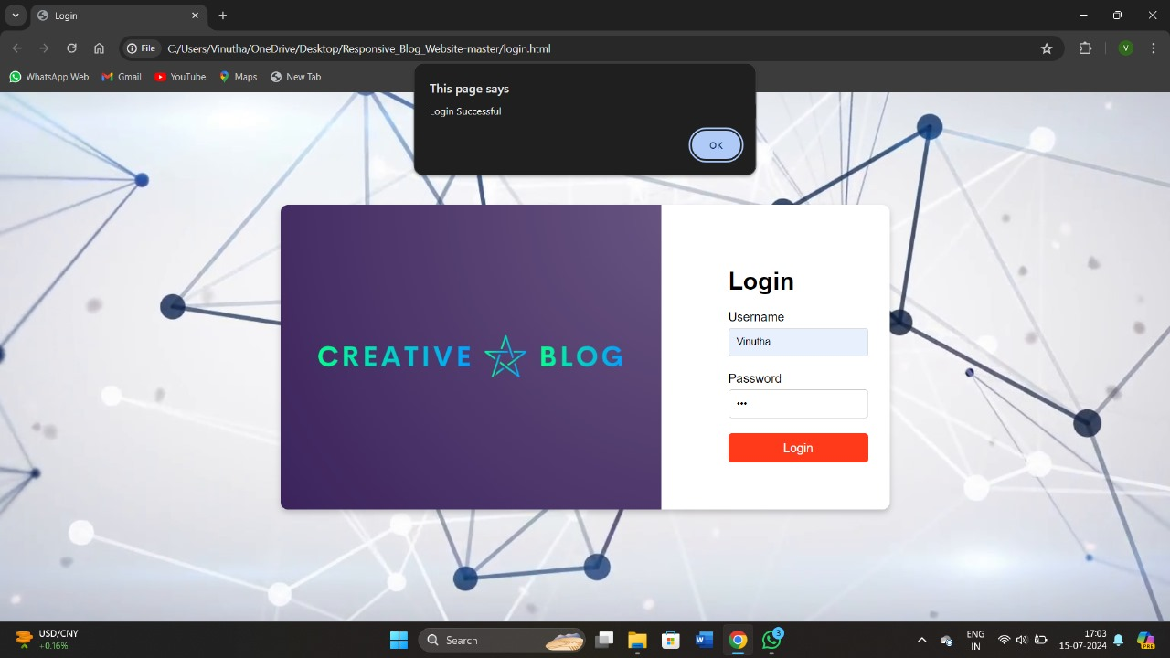
RESULTS AND DISCUSSION

Slide 18
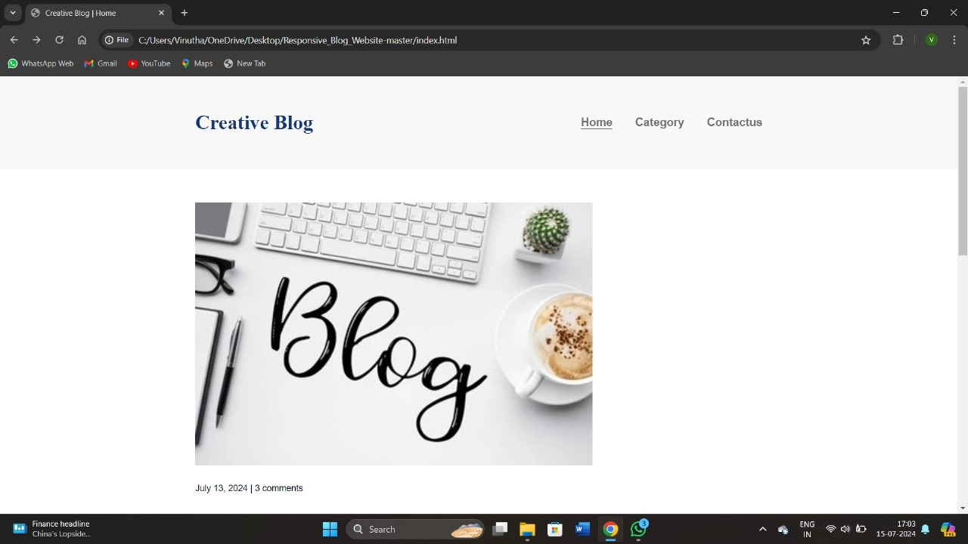
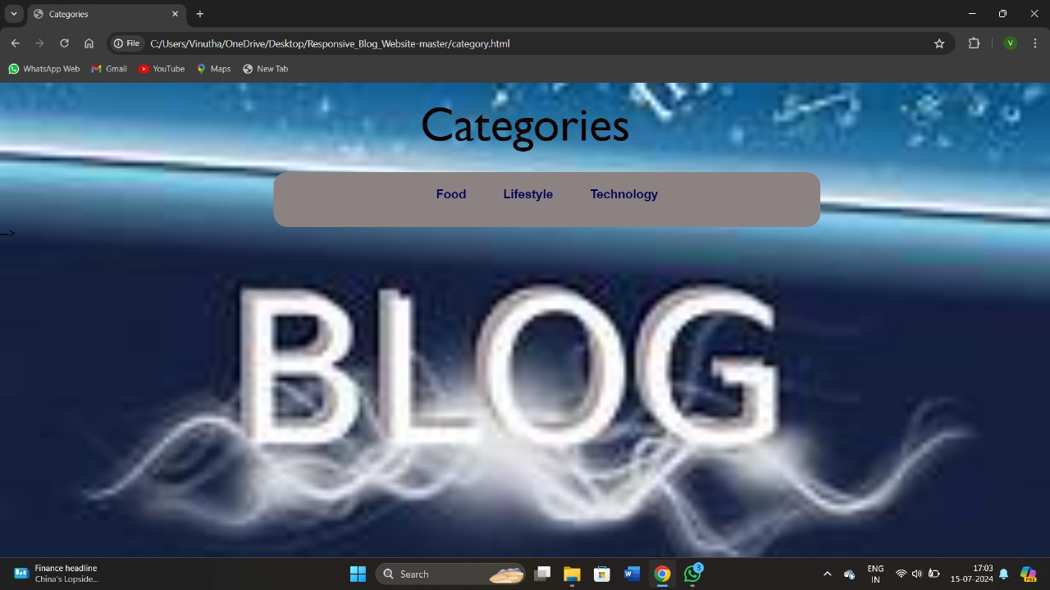
RESULTS AND DISCUSSION

Slide 19
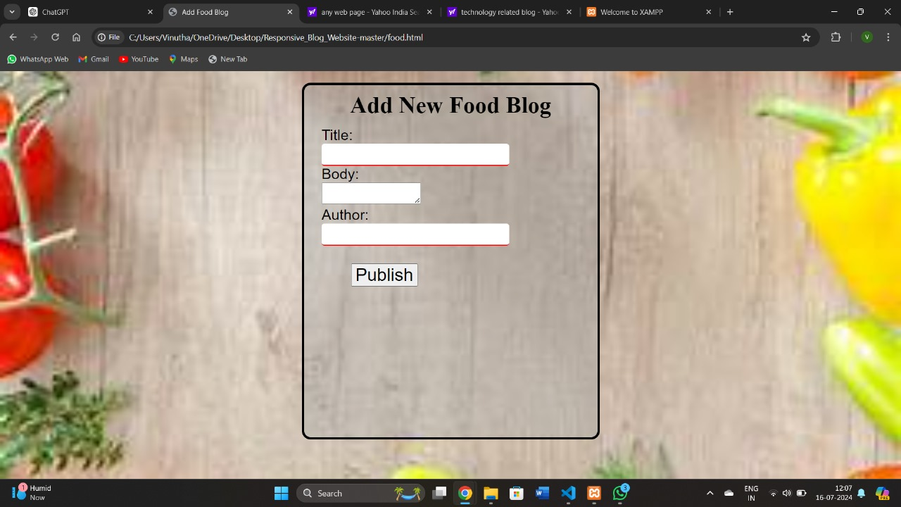
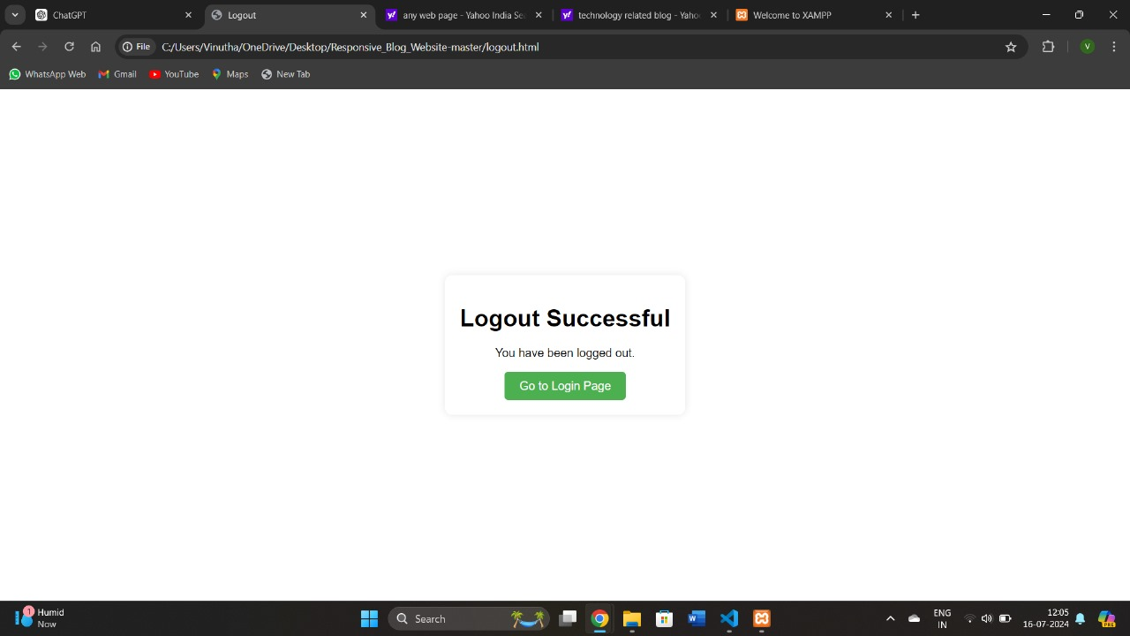
RESULTS AND DISCUSSION

Slide 20
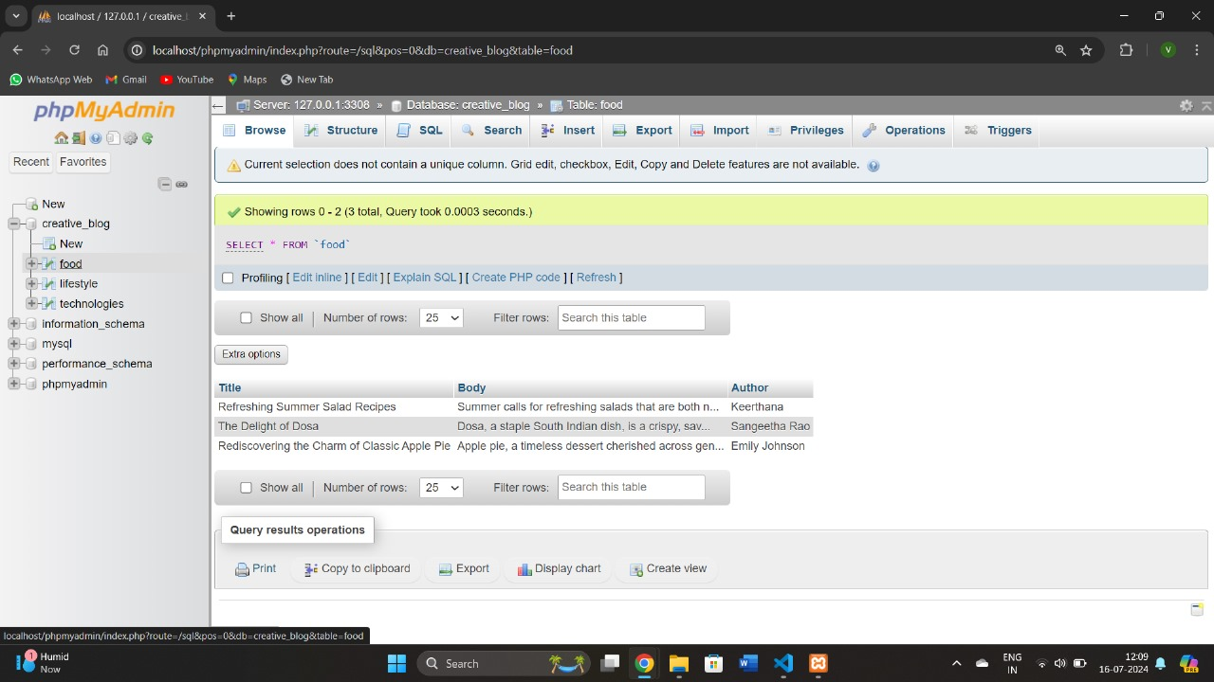
RESULTS AND DISCUSSION

Slide 21
CONCLUSION
  The blogging website developed using HTML, CSS, and JavaScript is designed to be simple, effective, and user-friendly. It provides a platform for users to express their ideas, share information, and engage with a wide audience through a visually appealing and responsive interface. Basic security measures ensure user data protection, contributing to a smooth and engaging user experience.

Slide 22
BIBILOGRAPHY
https://www.tandfonline.com/doi/abs/10.1080/13600830801886984
https://openai.com/chatgpt
https://github.com/kunaal438/blogging-site
https://www.researchgate.net/publication/351725158_A_Systematic_Review_of_Blogging_Opportunities_and_Challenges

Slide 23
THANK YOU

